Slide 1
Natural Language Processing Specialization Neural Networks for Sentiment Analysis
(2021 Deeplearning.ai)
YangXi’s Reading Notes

Slide 2
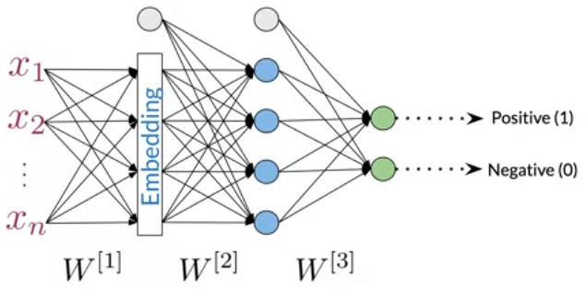
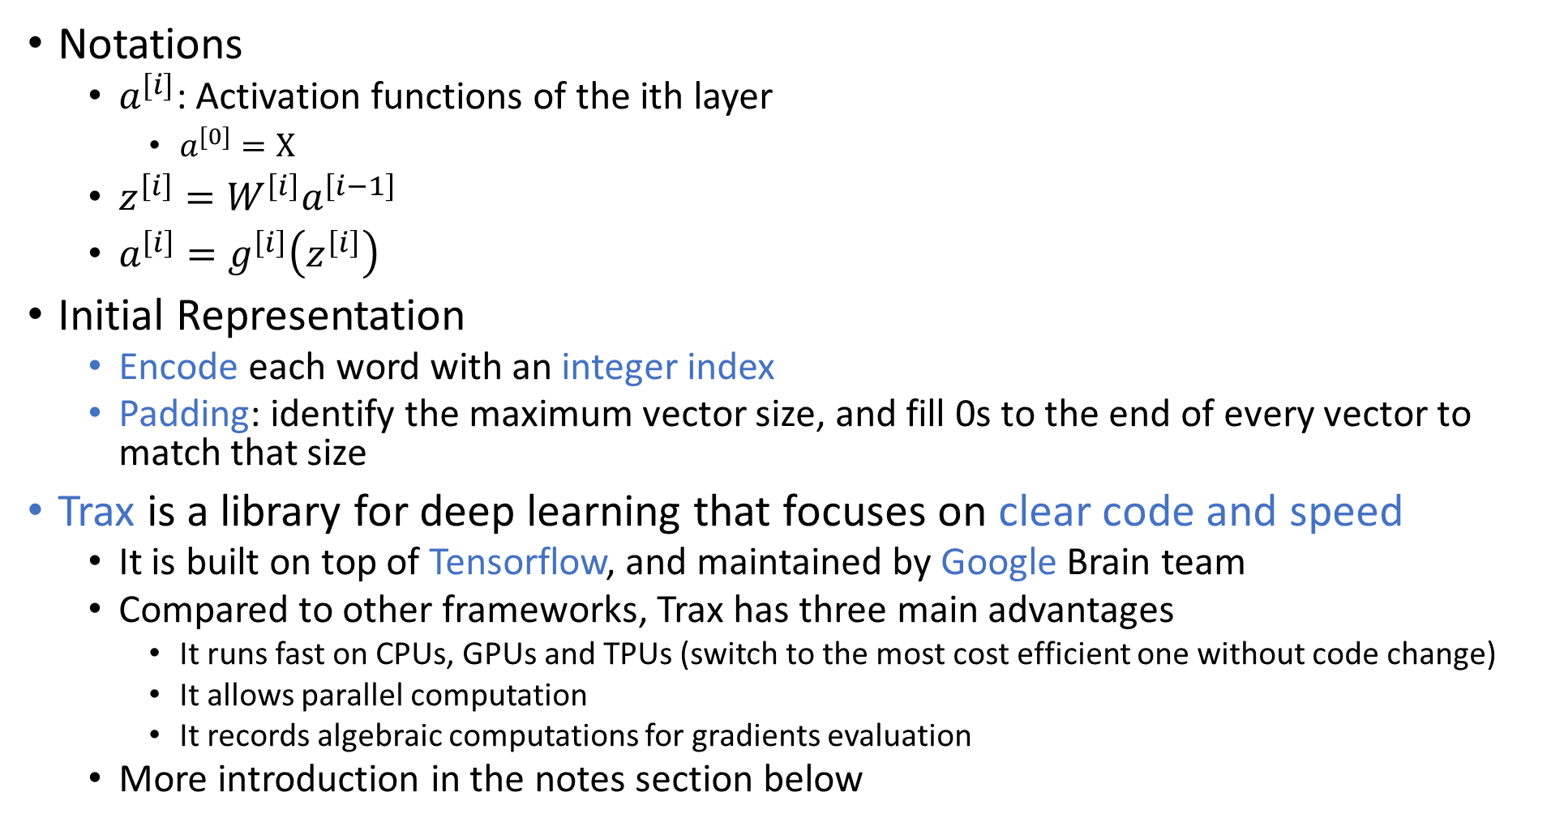
A Simple Trax NN for Sentiment Analysis of Tweets
Notations
$a^{[i]}$: Activation functions of the ith layer
$a^{[0]}=X$
$z^{\left[i\right]}=W^{\left[i\right]}a^{\left[i−1\right]}$
$a^{\left[i\right]}=g^{\left[i\right]}\left(z^{\left[i\right]}\right)$
Initial Representation
Encode each word with an integer index
Padding: identify the maximum vector size, and fill 0s to the end of every vector to match that size
Trax is a library for deep learning that focuses on clear code and speed
It is built on top of Tensorflow, and maintained by Google Brain team
Compared to other frameworks, Trax has three main advantages
It runs fast on CPUs, GPUs and TPUs (switch to the most cost efficient one without code change)
It allows parallel computation
It records algebraic computations for gradients evaluation
More introduction in the notes section below
Notes:
Trax is a library to learn and productionize machine learning research, and to understand machine learning models, especially sequential models, such as transformers.
The roadmap of Trax makes it especially suitable for Natural Language Processing.
From TensorFlow to Trax
TensorFlow (2015): the initial fast, distributed, large-scale system. The main focus was speed, followed by easy-to-program.
Google Translate (2016): It started with LSTM and RNN, now mostly transformers. The models took a long time to train, days on GPU clusters.
Tensor2Tensor (2017): Transformers make the training much faster. But it is complicated and hard to learn.
Trax comes with several advantages:
Bottom-up clean re-design
Easy to debug, you can read the code
Full models with dataset bindings included
Main models regression-tested daily
While Trax is not backward compatible to earlier systems.

Slide 3
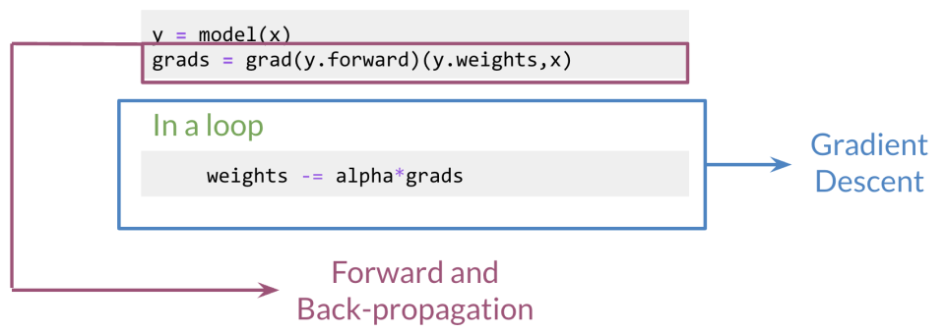
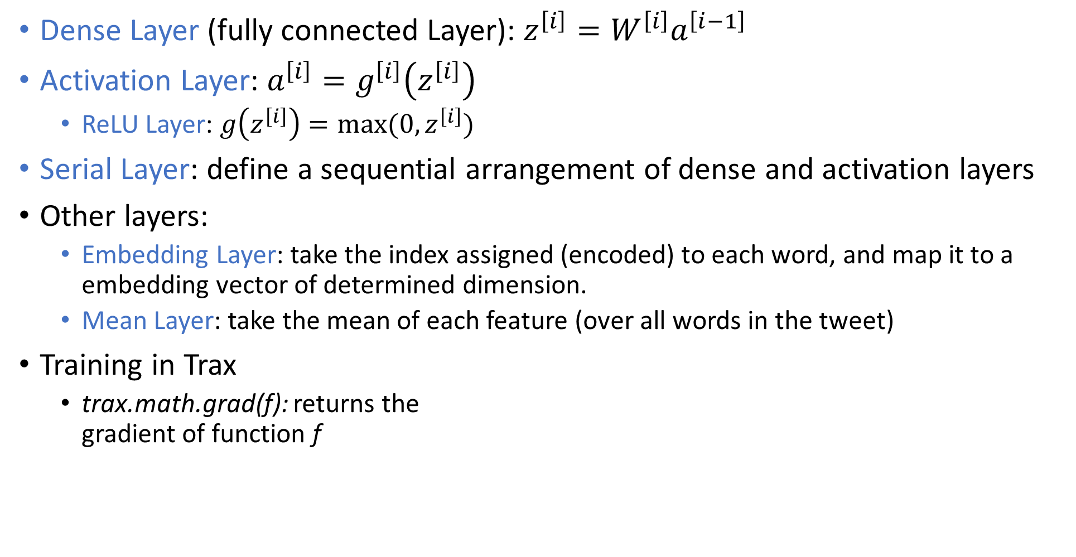
Trax Layers and Training
Dense Layer (fully connected Layer): $z^{\left[i\right]}=W^{\left[i\right]}a^{\left[i−1\right]}$
Activation Layer: $a^{\left[i\right]}=g^{\left[i\right]}\left(z^{\left[i\right]}\right)$
ReLU Layer: $g\left(z^{\left[i\right]}\right)=max⁡(0,z^{\left[i\right]})$
Serial Layer: define a sequential arrangement of dense and activation layers
Other layers:
Embedding Layer: take the index assigned (encoded) to each word, and map it to a embedding vector of determined dimension.
Mean Layer: take the mean of each feature (over all words in the tweet)
Training in Trax
trax.math.grad(f): returns the gradient of function f

